Slide 1
XML (Extensible Markup Language)
Document Structure & Basics

Slide 2
What is XML?
- XML stands for Extensible Markup Language.
- Extensible means :create our own tag
- It is used to store and transport data
- It is both human-readable and machine-readable
- Focus is on data structure, not display

Slide 3
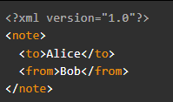
XML Document Structure
- Prolog (optional)
- Root element (mandatory)
- Child elements

Slide 4
XML Syntax Rules
- Must have single root element
- All tags must be closed
- Case-sensitive tags
- Proper nesting required
- Attribute values must be quoted

Slide 5

Tags in XML
Tags define the start and end of elements
Two types:
Opening tag:
Closing tag:

Slide 6

Elements in XML
An element includes:
Start tag
Content
End tag
Elements can also be nested

Slide 7

Attributes in XML
Provide extra info about elements
Written inside start tag
Example:

Slide 8
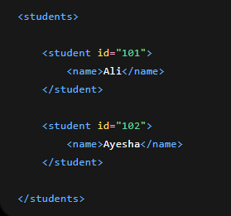
XML ID
An ID in XML is used to uniquely identify a specific data record.
Why Do We Use ID?
To identify data uniquely
To avoid confusion between records
To easily find specific data

Slide 9
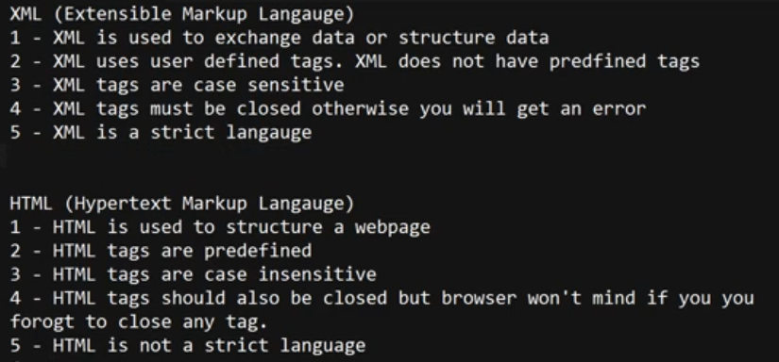
Difference between XML AND HTML

Slide 10
Well-Formed XML
- Follows all syntax rules
- Proper nesting
- Single root element
- All tags closed

Slide 11
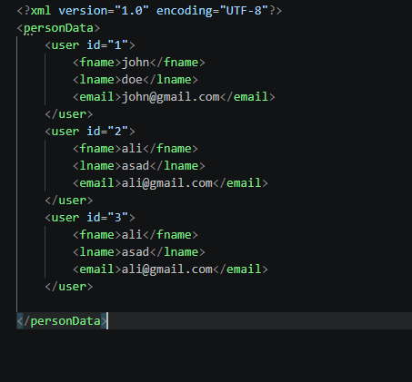

Slide 12
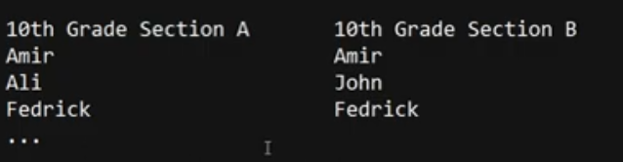
Use of namespace
XML namespace is used to give unique identity to elements with the same name, so confusion can be avoided.
Namespace is used when system becomes BIG and complex.
We use namespace to resolve the naming conflict issue.

Slide 13
Difference B/W ID and Namespace in XML
Thing | ID | Namespace
What does it make unique? | Data / Record | Tag Name
What problem does it solve? | Identifies which exact record it is | Identifies which system/category the tag belongs to
Example | student id="101" | school:table

Slide 14

Malformed XML
- Incorrect XML
- Breaks XML rules
- Missing tags
- Improper nesting
Example:

Slide 15
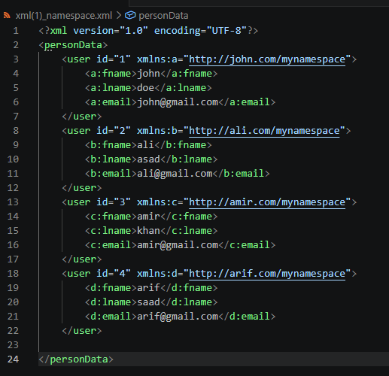
Practical

Slide 16
Task
Write a well-formed XML document (employee list)
A well-formed XML document must follow these rules:
one root element
proper closing tags
correct nesting
case-sensitive tags
Use: namespace for avoiding conflicts

Slide 17
Task
Validate XML using online XML Validator(Validation means checking whether:
XML structure is correct
tags are properly written
no syntax errors exist) can use codebeautify
• View XML in browser and editor

Slide 18
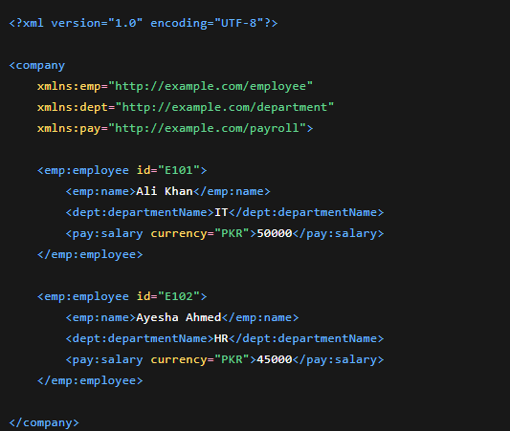

Slide 19
Summary
- XML stores and transports data
- Uses tags, elements, attributes
- Strict syntax rules
- Well-formed XML is valid

